Slide 1

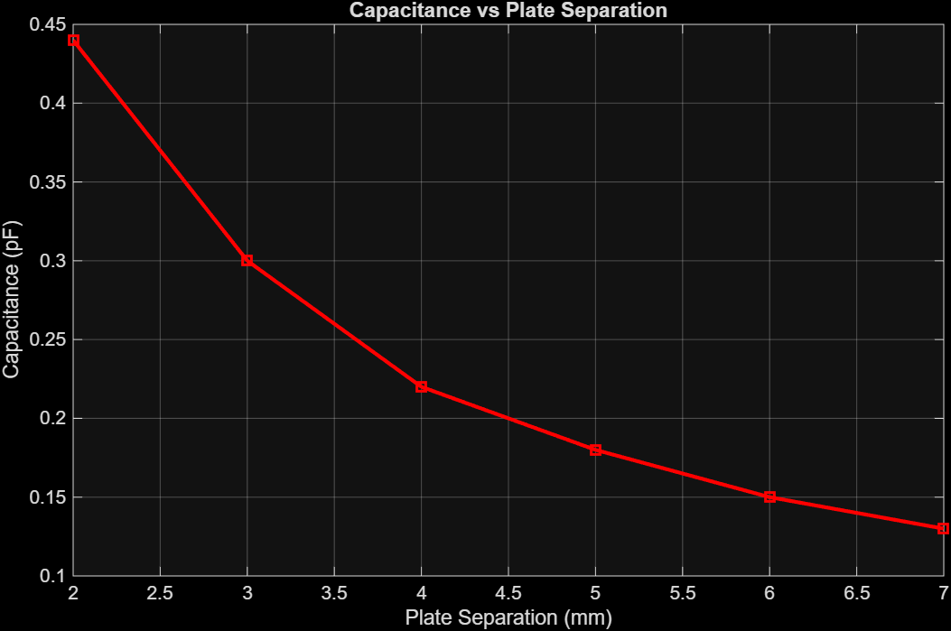
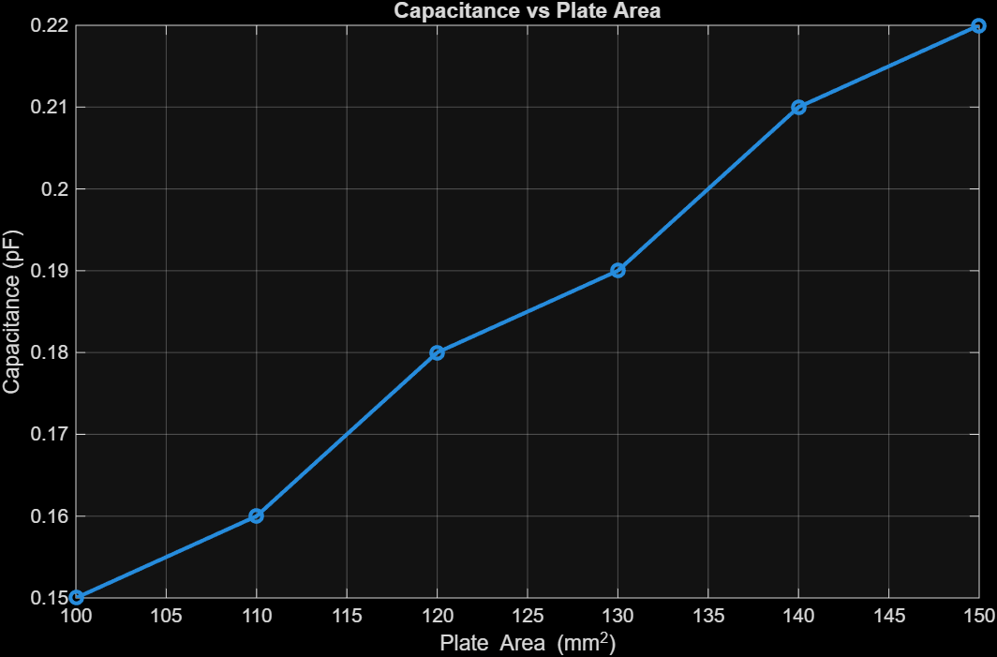





How Plate Area and Separation Affect Capacitance and Energy Storage
Abdon Morales^{1,2} ¹Department of Economics, College of Liberal Arts ²Department of Computer Science, College of Natural Sciences, The University of Texas
Introduction
Figures and Results
Conclusion
Capacitors are key components in many electrical systems because they store energy and help regulate voltage. A parallel-plate capacitor consists of two metal plates separated by an insulating material, and its capacitance depends on the size of the plates and the distance between them. For an air-filled capacitor, the formula $C=ε_{0}\frac{A}{d}$ shows that capacitance increases with plate area and decreases as the plates are moved farther apart. Understanding this relationship is important for designing capacitors used in practical applications.
In this project, we tested how changing plate area and separation affects capacitance and stored energy. We used adjustable metal plates, a micrometer to measure distance, and a capacitance meter to take readings while keeping the applied voltage constant. Data was collected for different plate sizes and separations see how real measurements compare to theory.
>> tscoreTesting
Seperation: mean=0.2367, sd=0.1062, n=6, t=5.4562, p=0.0028
Area: mean=0.1850, sd=0.0250, n=6, t=18.1262, p=0.0000
Two-sample t-test: t=1.0584, df=10, p=0.3147
I concluded that the experimental results confirm the theoretical relationships governing capacitance in parallel plate capacitors. As plate separation increased from 2 mm to 7 mm, capacitance decreased significantly; demonstrating that the expected inverse dependence on distance. Conversely, increasing plate area from $100 mm^{2}$ to $150 mm^{2}$ produced a clear rise in capacitance, consistent with the direct proportionality predicted by the capacitance formula $C=ε_{0}\frac{A}{d}$. Statistical analysis showed that both trends were highly significant, reinforcing the validity of the theoretical model. These findings highlight how geometric factors strongly influence energy storage in capacitors, with plate separation exerting a greater effect than plate area within the tested ranges. Overall, the experiment successfully verified the fundamental principles of electrostatics and demonstrated the practical importance of capacitor design parameters.
Research Goal
Figure 1: Capacitance vs. Plate Separation
To examine how plate area and plate separation affect the capacitance and energy storage of a parallel-plate capacitor, and to compare the measured results with the theoretical relationship $C=ε_{0}\frac{A}{d}$.
Methods
Acknowledgments
To investigate the effect of plate area and plate separation on the capacitance of a parallel-plate capacitor, I designed an experiment using adjustable metal plates, a regulated DC voltage source, and a digital capacitance meter. The plates were mounted on a frame that allowed precise control of both their surface area and the distance between them. A micrometer screw gauge was used to measure and adjust the separation with millimeter accuracy, while interchangeable plates of varying sizes were employed to modify the area. The voltage source was set to a constant value throughout the experiment to ensure that changes in capacitance were solely due to geometric variations.
The experiment was conducted in two parts. In the first part, the plate separation was fixed at 6mm, and the plate area was systemically increased in increments from $100 mm^{2}$ to $150 mm^{2}$. For each configuration, the capacitance was measured using the digital meter, and the corresponding energy stored in the capacitor was calculated using the formula $E=\frac{1}{2}CV^{2}$. In the second phase, the plate are was held constant to $100 mm^{2}$, while the separation was varied from 2 mm to 7mm in steps of 1 mm. In addition, capacitance readings were recorded for each setting, and energy values were computed; all measurements were repeated to confirm consistency, and the data was organized into two sets: one for capacitance versus plate area and another for capacitance versus plate separation. These datasets were late analyzed to identify trends and compare experimental results with theoretical predictions based on the equation $C=ε_{0}\frac{A}{d}$
I would like to express my gratitude to Professor Aaron Zimmerman for his instruction in Engineering Physics II, which provided the theoretical foundations for this research. I also thank Professor Seth Bank for his guidance on the underlying electrical engineering concepts. Finally, I would like to acknowledge my Lab TA, Tannishtha Nandi, for facilitating access to the laboratory equipment and providing the necessary statistical tools for our data analysis throughout the semester.
Figure 2: Capacitance vs. Plate Area
References
The experimental results demonstrate the relationship between capacitance and two key variables: plate separation and plate area. Shown in Figure 1, capacitance decreases as plate separation increases; following an inverse trend consistent with the theoretical prediction. Specifically, capacitance drops from approximately 0.44 pF at a 2 mm separation to about 0.13 pF at 7mm; indicating that greater distance between plates significantly reduces the ability to store charge.
Conversely, Figure 2 illustrates that capacitance increases with plate area, rising from roughly 0.15 pF at $100 mm^{2}$ to 0.22 pF at $150 mm^{2}$. This positive correlation aligns with the expectation that larger plate surfaces enhance charge storage capacity.
[1] F.T Ulaby, M.M. Maharbiz, C.M. Furse, Circuit Analysis and Design, 2nd ed. Ann Arbor, MI, USA: Michigan Publishing, 2024
[2] H.C Ohanian and J.T Markert, Physics for Engineers and Scientists, 3rd ed., vol. 2. New York, NY, USA: W.W. Norton & Company, 2007.

